Slide 1
TIME SERIES ANALYSIS
By
Kapil Thakkar & Reshma Kumari
Under Guidance of
Dr. Aaditeshwar Seth

Slide 2
Motivation
Analysis of time series can reveal different events/incidents which may be useful
Supply demand imbalance, natural calamities etc. may not always be the reason behind the rise in the price of a commodity
It may be a consequence of artificial supply deficit planned intelligently by traders’ Nexus for profiteering through manipulation of supply of commodity and hence indirectly controlling their prices
Our attempt is to locate such hikes in prices which seem suspicious (we call them anomalies)

Slide 3
Objective
To develop a library which detect anomalies in multiple time series of a system
Try to justify the reported anomalies with news articles

Slide 4
Anomaly Scenarios
Wholesale Price\Arrival | ↑ | ↔ | ↓
↑ | A | A | -
↔ | A | - | -
↓ | - | - | -
Retail Price\Arrival | ↑ | ↔ | ↓
↑ | A | A | -
↔ | A | - | -
↓ | - | - | -
Retail Price \Wholesale Price | ↑ | ↔ | ↓
↑ | - | A | A
↔ | - | - | A
↓ | - | - | -
Retail Price\Other Retail Price | ↑ | ↔ | ↓
↑ | - | A | A
↔ | - | - | A
↓ | - | - | -

Slide 5
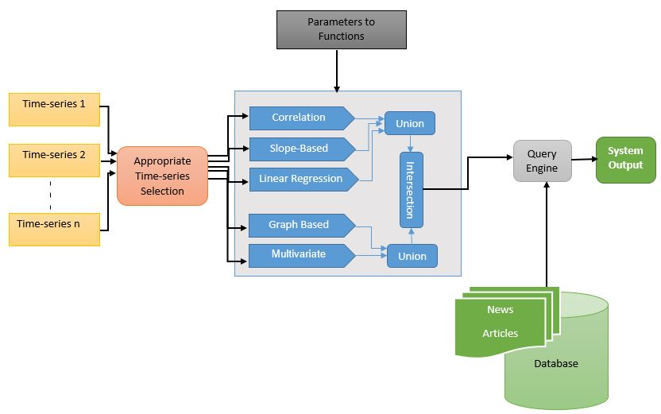
System Design

Slide 6
Onion Data
Daily wholesale price of onion for 1514 mandis
Daily arrival of onion information for 1514 mandis
Daily retail price of onion for 76 centres
Longitude and latitude of mandis and centres
Crawlers were written to collect the data from these date-wise for the period of approximately 9.5 years, starting from 1st January 2006 to 6th July 2015.
Dates and location for hoarding reports from news articles
Total 453 news articles were collected, 267 articles were relevant after studying manually

Slide 7
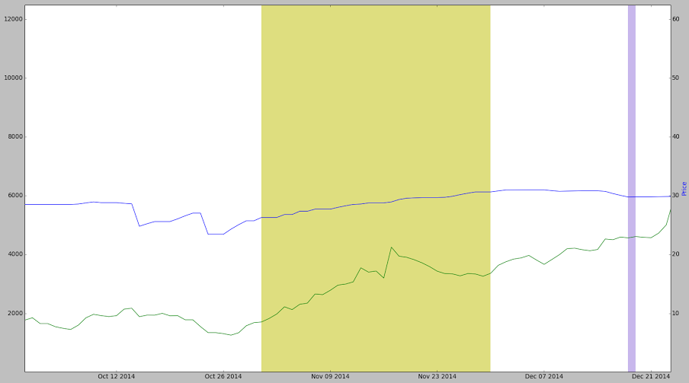
What System Detects?
Correlation Method-
Captures when series go out of sync
Example- Mumbai for month of November 2014
Retail price continued to show increase despite decrease in arrival
Green- Arrival in tons , Blue- Retail Price

Slide 8
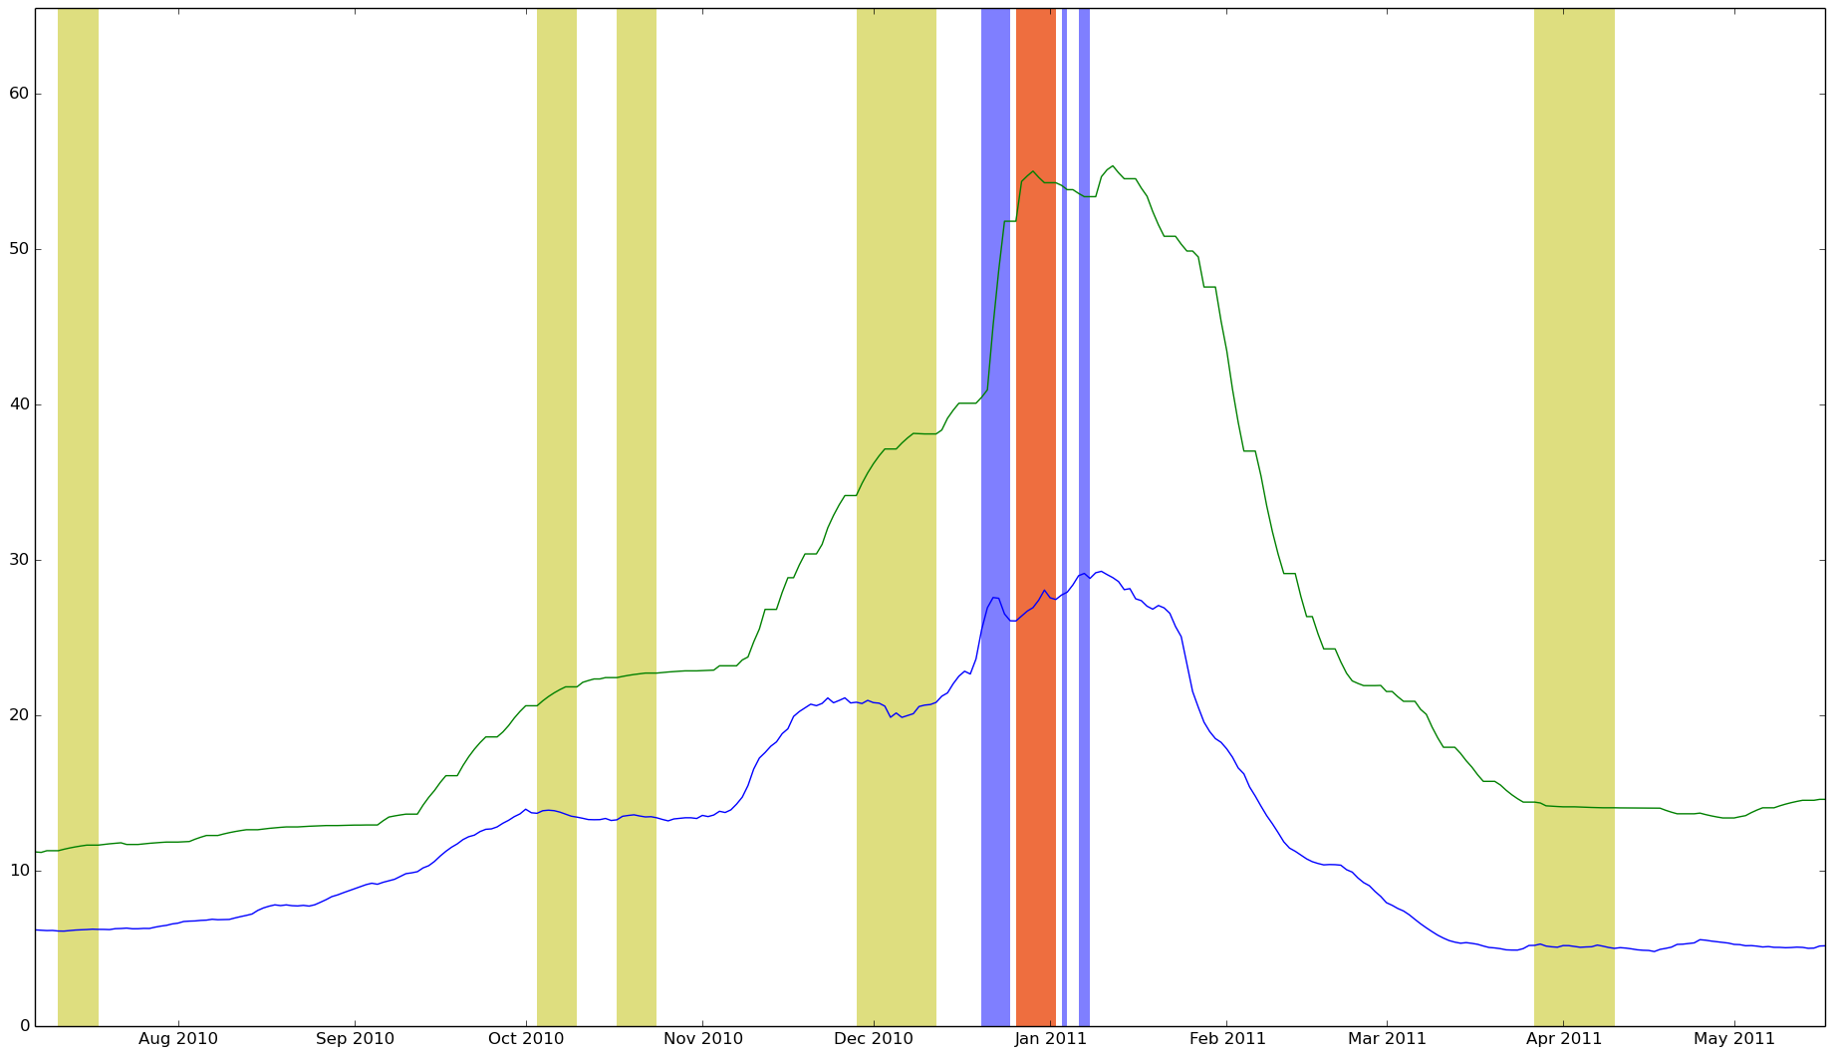
What System Detects?
Slope Based Method-
Captures when change in one series is high with respect to other
Example- Mumbai for month of December 2010 – January 2011
The rate at which retail prices raised was not seen in case of wholesale price
Green- Retail Price, Blue- Wholesale Price

Slide 9
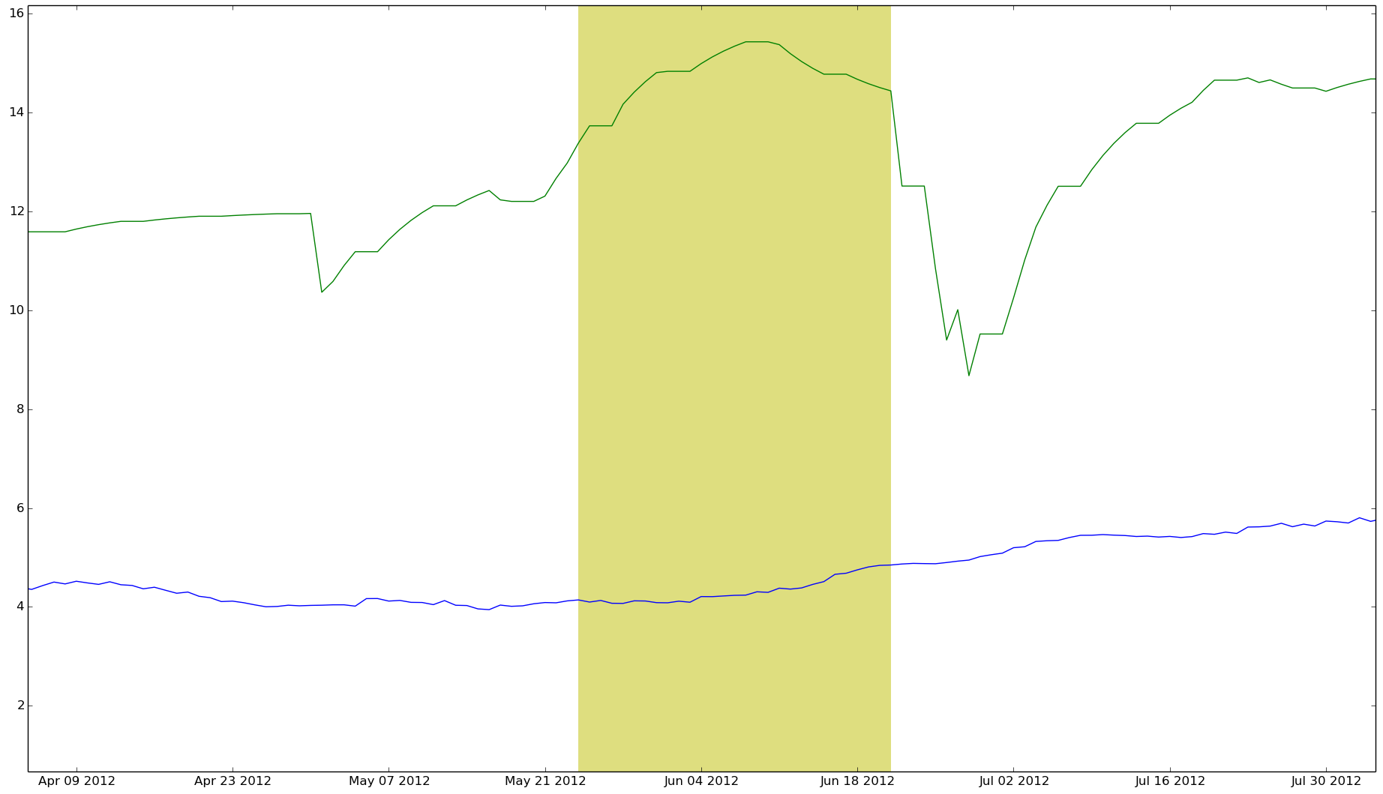
What System Detects?
Linear Regression Method-
Captures when real value is too high than expected value
Example- Mumbai for month of June 2012
Increase in Retail prices were large compared to the wholesale prices
Green- Retail Price, Blue- Wholesale Price

Slide 10
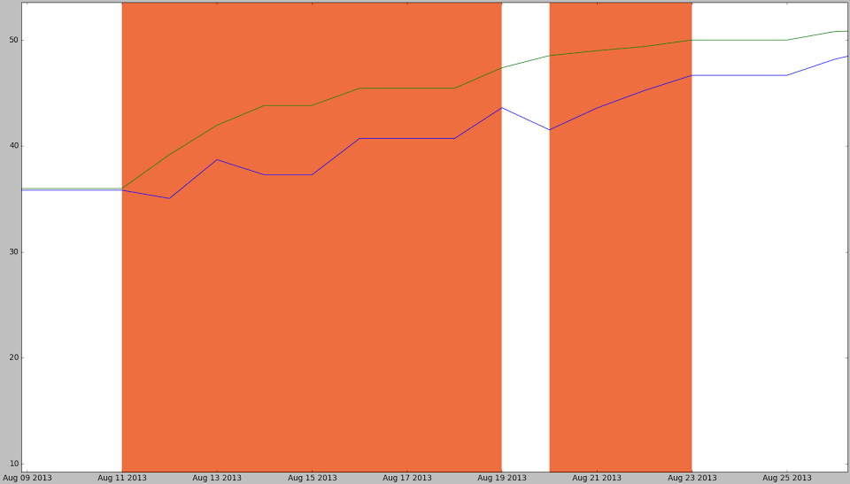
What System Detects?
Result of System for,
Retail Price vs Average Retail Price:
Captures when change in retail price at one centre is high as compared to average retail price
Example- Mumbai for month of August 2013
Retail price in Mumbai increased whereas Delhi did not see much of hike
Green- Retail Price, Blue- Average Retail Price

Slide 11
What System Detects?
Trend? Seasonality?
These 3 methods do not capture that
We have two more methods for this
Graph Based Anomaly Detection
Multivariate Anomaly Detection

Slide 12
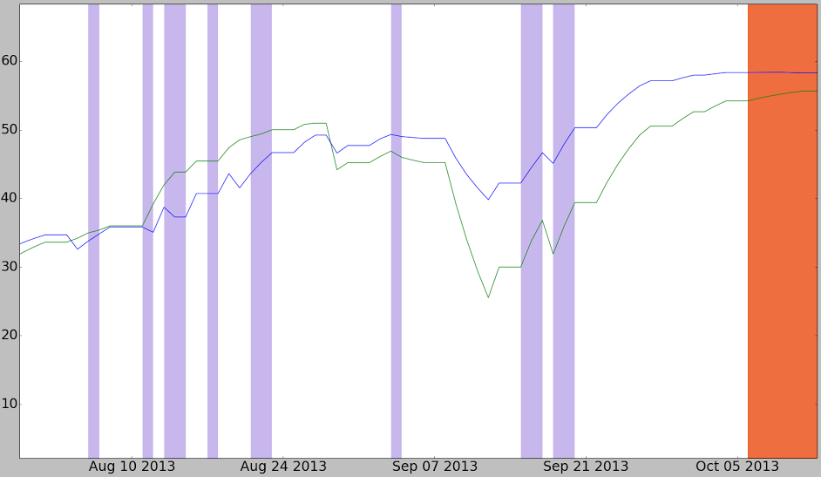
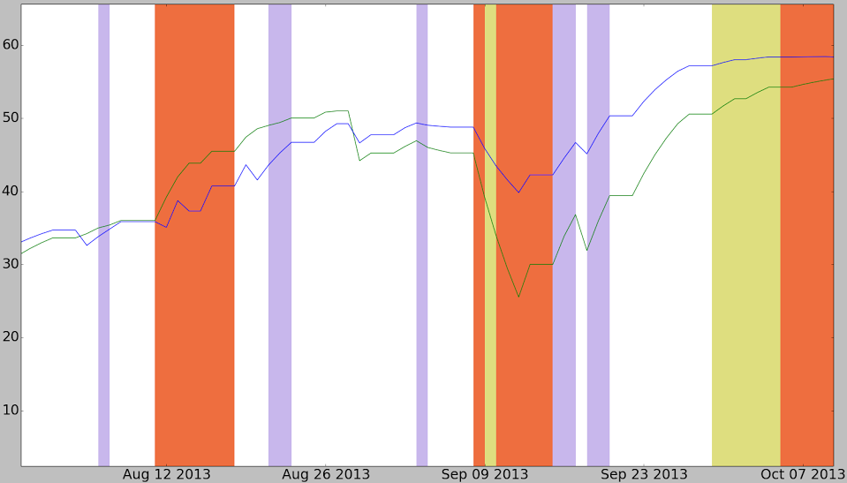
Why Union?
Mumbai – August 2013, Retail Price vs Average Retail Price Analysis
Correlation Based
Slope Based
Green- Retail Price, Blue- Average Retail Price

Slide 13
Why Intersection?
Results for lean months
Month | Union(WC , LR , SB) | Union(GB , MV)
May | 63 | 18
June | 94 | 24
Results for non-lean months
Month | Union(WC , LR , SB) | Union(GB , MV)
January | 46 | 46
February | 70 | 57

Slide 14
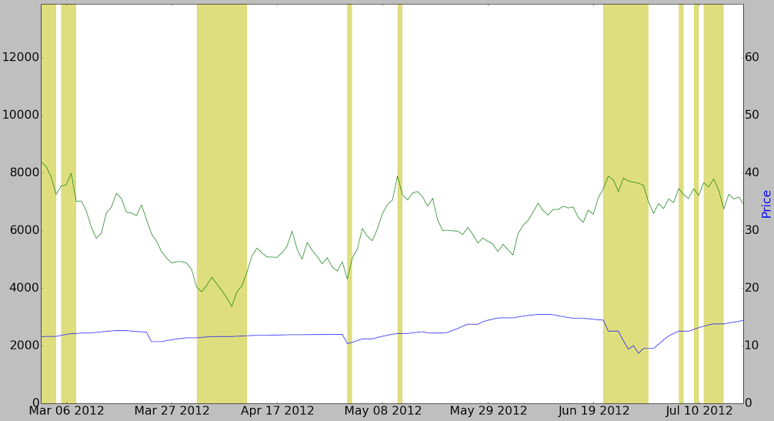
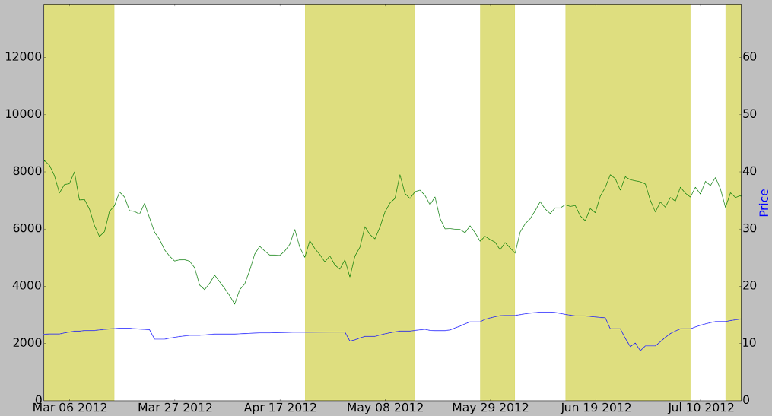
Why Intersection?
Mumbai – May June 2012, Retail Price vs Arrival Analysis
Union(GB , MV)
Union(WC , LR , SB)
Green- Arrival, Blue- Retail Price

Slide 15
Detailed Results for Mumbai
 | Anomalies Reported | Anomalies Matched
Retail Price vs Average Retail Price | 125 | 64
Retail Price vs Arrival | 323 | 153
Retail Price vs Wholesale Price | 160 | 52
Wholesale Price vs Arrival | 332 | 168
Low anomalies reported for Retail Price vs Average => Centres move in tandem
Low Retail Price vs Wholesale Price => Retail moves in sync with wholesale
System performs better with arrival

Slide 16
Detailed Results for Mumbai
 | Articles Not Matched | Articles not matched which stated traders’ nexus as reason
Retail Price vs Average Retail Price | 49 | 12
Retail Price vs Arrival | 33 | 9
Retail Price vs Wholesale Price | 52 | 14
Wholesale Price vs Arrival | 29 | 7
Nearly 75% of the articles with traders nexus as reason were captured by system

Slide 17
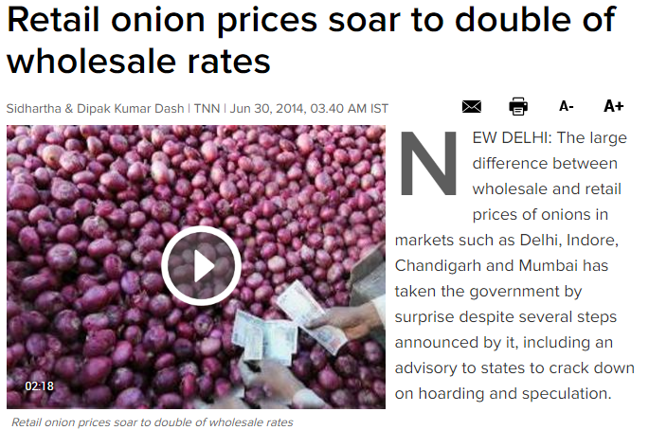
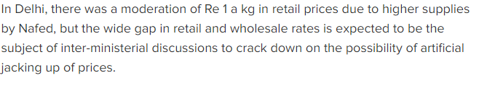
Findings – Matched Anomaly
Delhi- 29-Jun-2014 to 06-July-2014
Green- Arrival in tons , Blue- Retail Price

Slide 18
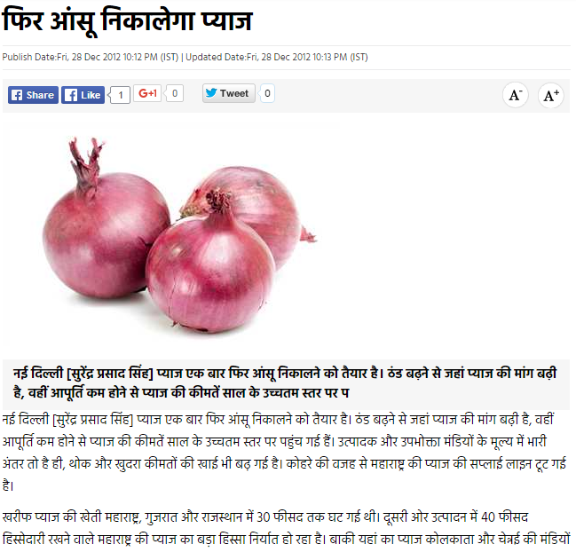
Findings – Local Anomaly
Delhi- 07-Jan-2013 to 08-Jan-2013
Green- Arrival in tons , Blue- Retail Price

Slide 19
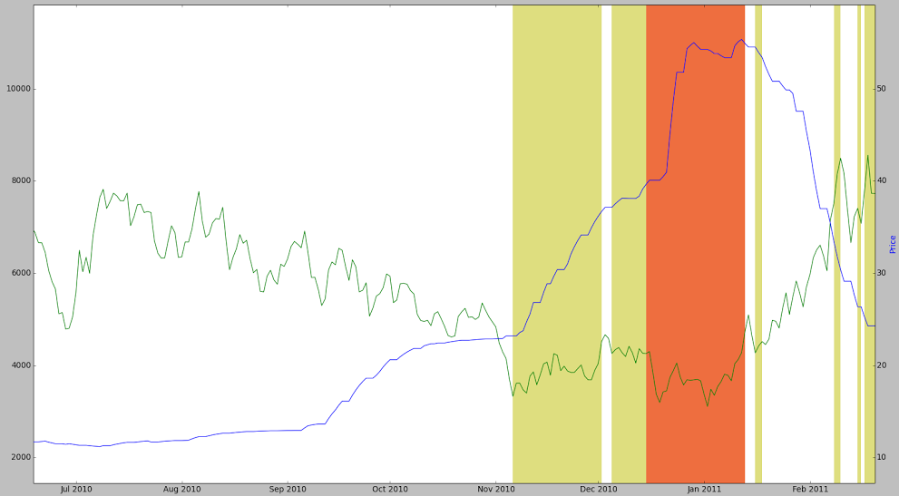
Findings – Reported but Not Matched
Mumbai – 07-Nov-2010 to 01-Dec-2010
Retail Price vs Arrival Result by System

Slide 20
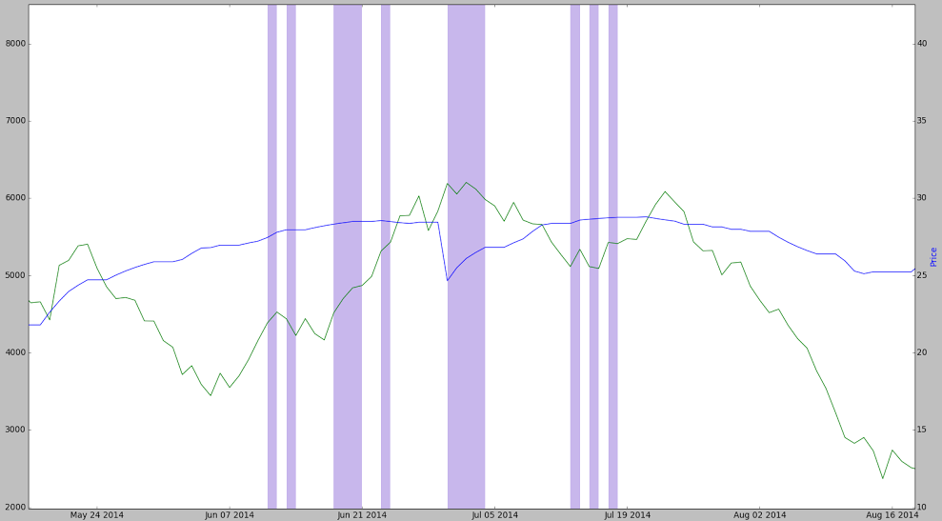
Findings – Articles Missed
Mumbai –11-Jun-2014 to 17-July-2014
Retail Price vs Arrival Result by System

Slide 21
Limitations
Few articles with traders’ nexus are still not reported by system
Result dependent on configuration of library functions
Window Size

Slide 22
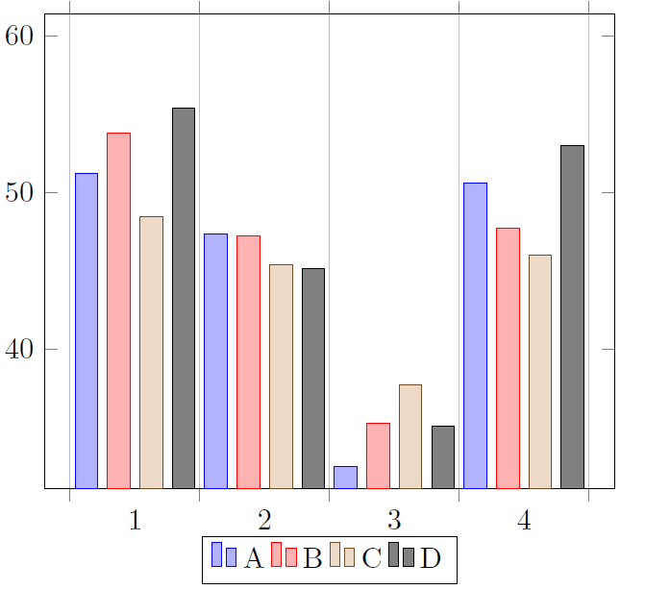
Limitations
A - Result with 15 as Correlation and 7 as Slope Based Window
B - Result with 10 as Correlation and 4 as Slope Based Window
C - Result with 20 as Correlation and 4 as Slope Based Window
D - Result with 7 as Correlation and 4 as Slope Based Window
1-Retail Price vs Average Retail Price
2-Retail Price vs Arrival
3-Retail Price vs Wholesale Price
4-Wholesale Price vs Arrival
Percentage of Anomalies Matched with News Articles

Slide 23
Limitations
Few articles with traders’ nexus are still not reported by system
Result dependent on configuration of library functions
Window Size
Threshold Value
Number of anomalies to be reported
Manual analysis of news articles is required

Slide 24
Conclusion
Time series analysis can bring more insights to data
In the case of onion, abnormal behaviour can help to detect important events or incidents like hoarding
Most of the results were justified using news articles
Library developed is generic, so can be applied to any time-series which have some sort of dependency on each other

Slide 25
Future Work
New methods can be added to refine results like Spike Detection
New techniques to define default threshold values can be used
Local anomalies to centre can be justified by local news sources
Can be extended further to locate anomalies in Supply Chain

Slide 26
THANK YOU!!! ANY QUESTIONS?

